Slide 1
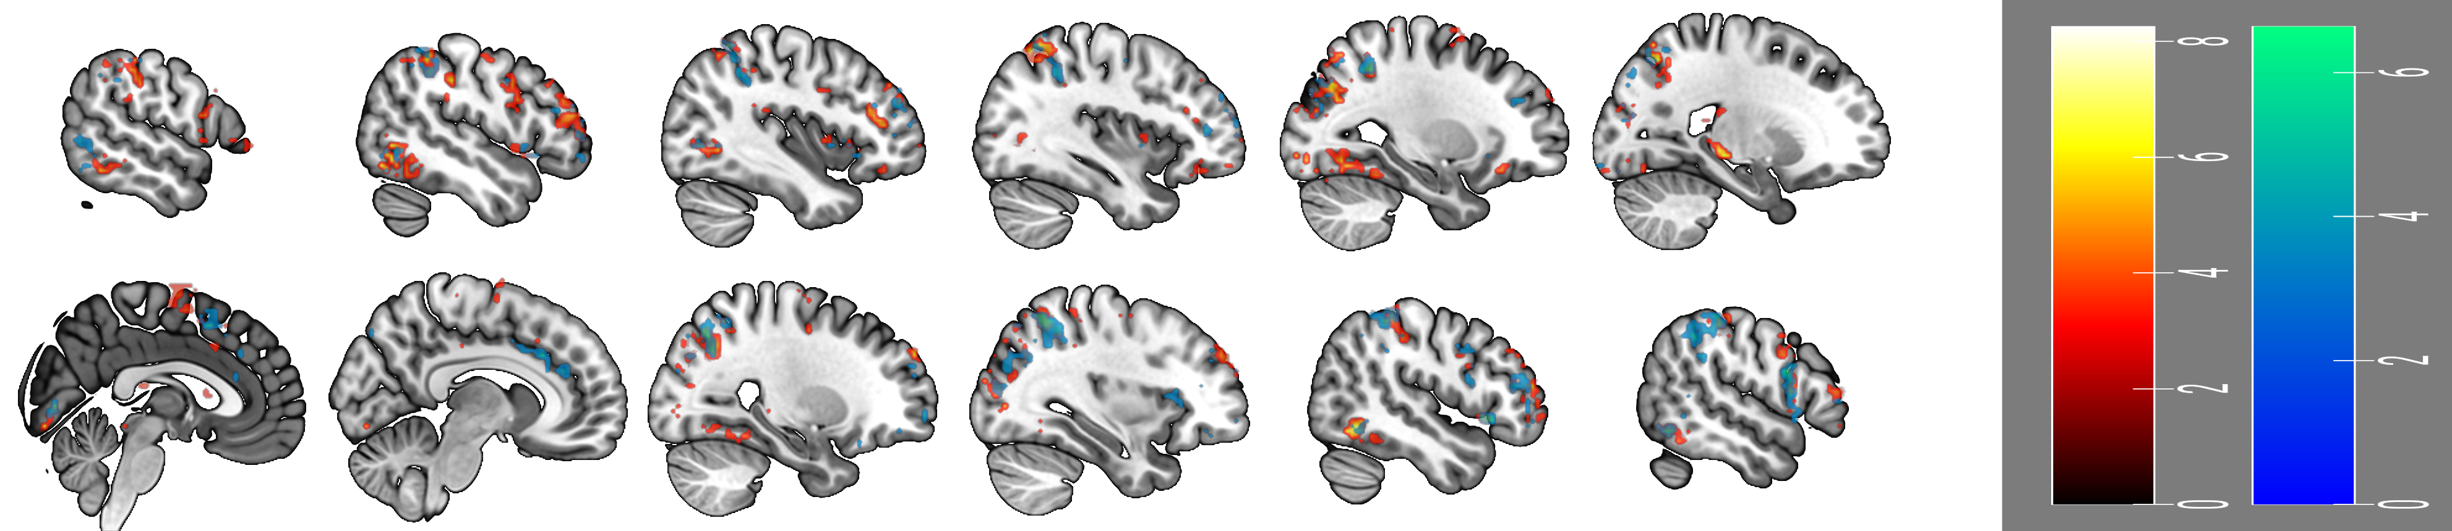
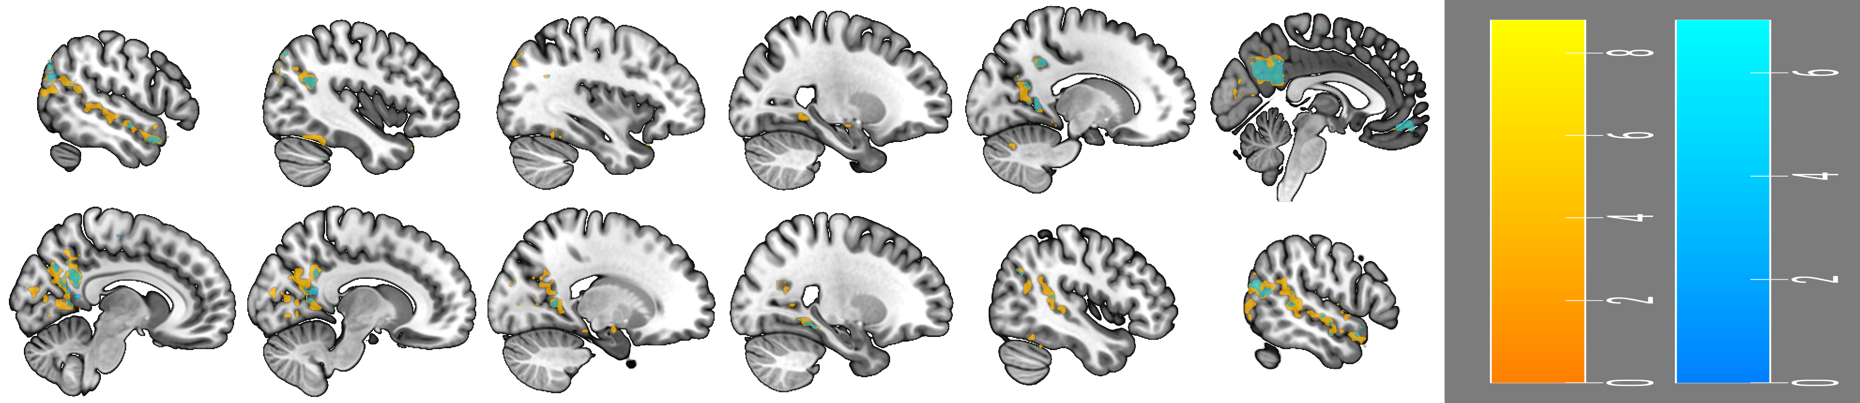
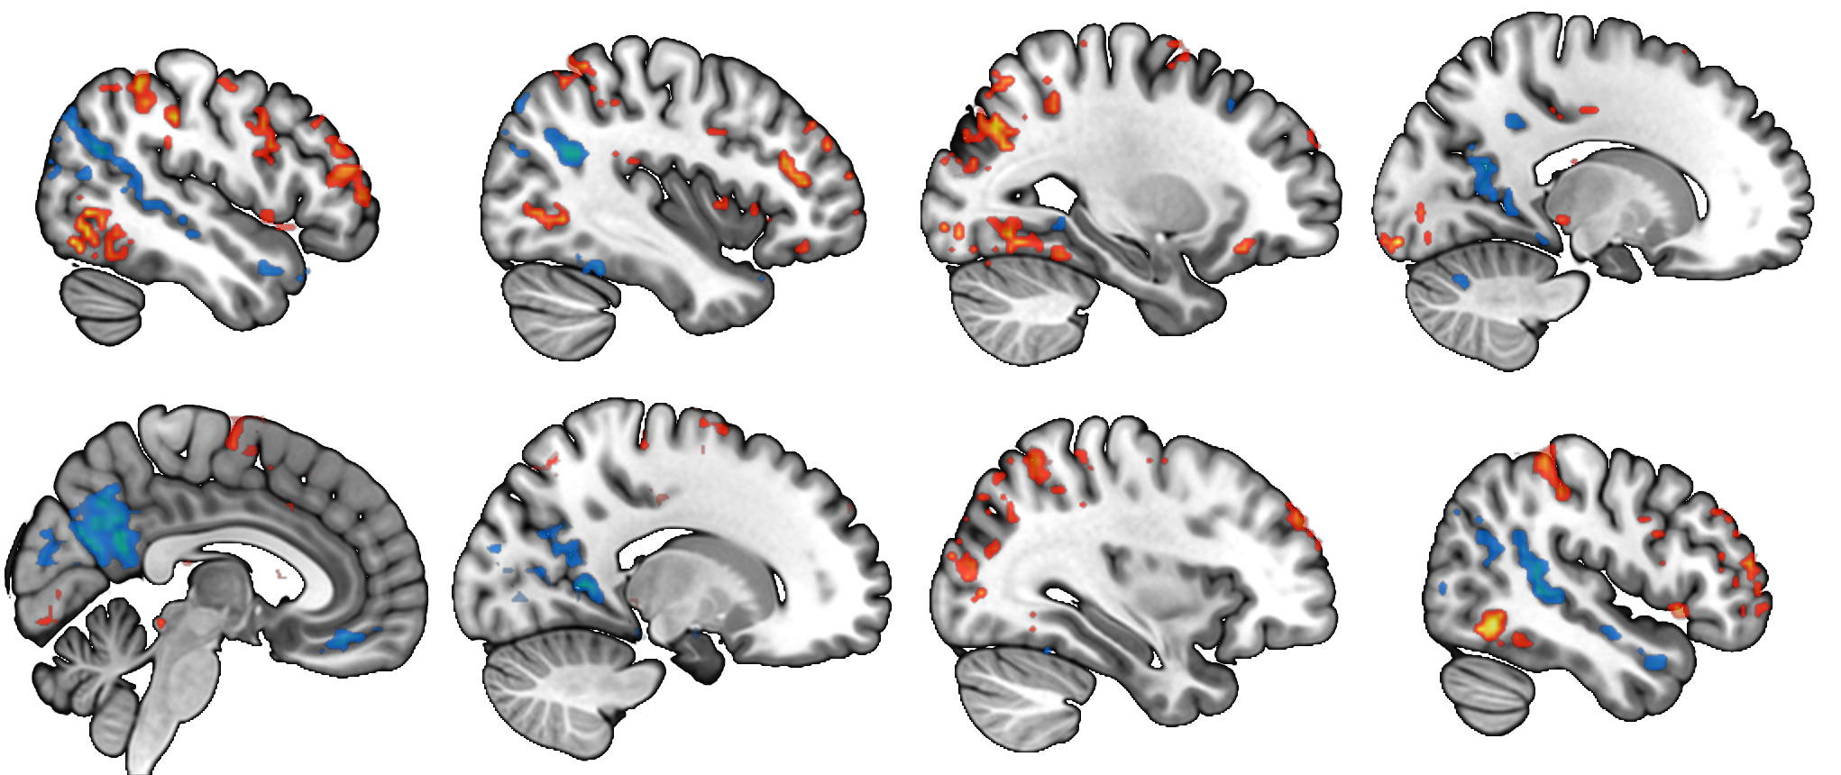
-49
-40
-28
-16
6.6
8.8
P
A
Expr. Rating > Reflect. Not Rating
Reflect. Not Rating > Expr. Rating
+04
+16
+33
+47
0.0
0.0

